Slide 1
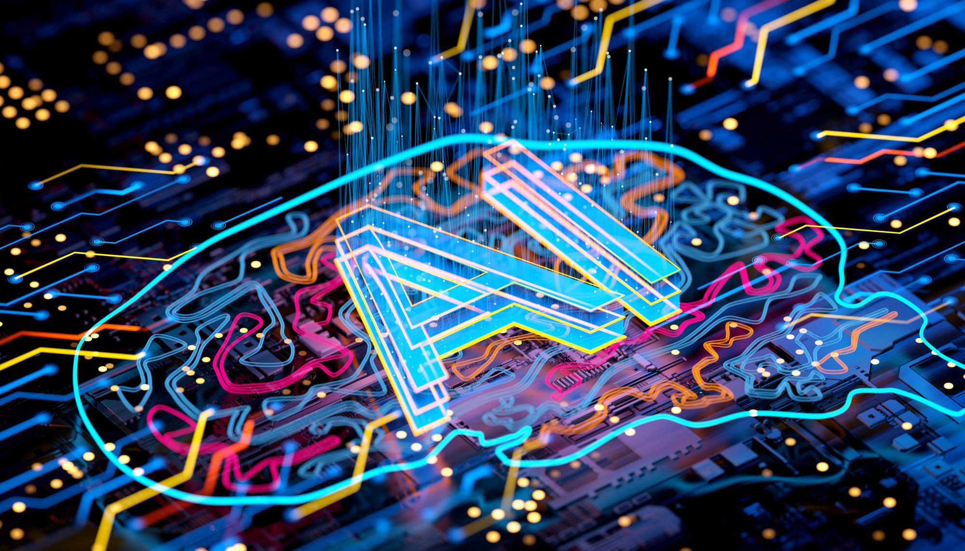
ARTIFICIAL INTELLIGENCE
SHAPING THE FUTURE

Slide 2
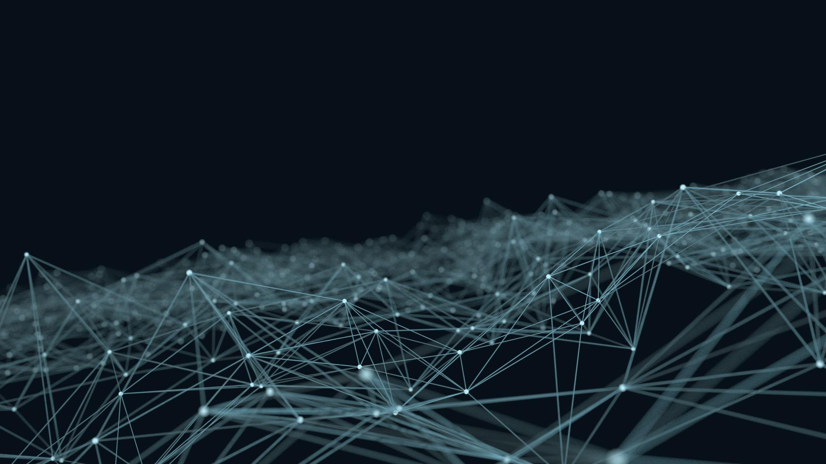
CONTENTS
Challenges / Disadvantage
Introduction to AI
Applications of AI
Types of AI
How AI Works
The Future of AI
History & Evolution
Advantages of AI

Slide 3



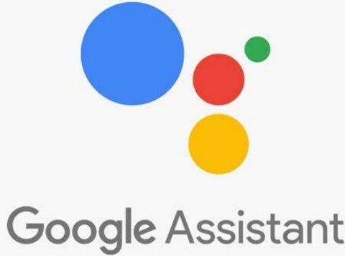
INTRODUCTION TO AI
What is Artificial Intelligence?
AI means machine intelligence that mimics human thinking
Example: Siri, Google Assistant, Chat GPT, Copilot
Chat GPT
SIRI
COPILOT
GOOGLE ASSISTANT

Slide 4
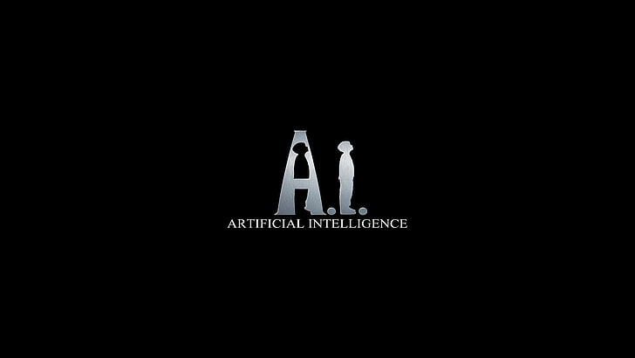
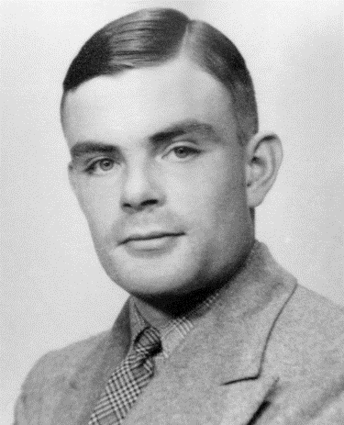

HISTORY & EVOLUTION
1950s: Alan Turing Test
1956s: Term ‘Artificial Intelligence’ coined
Milestones: IBM’s Deep Blue, Google’s AlphaGo
Sir, Alan Turing

Slide 5
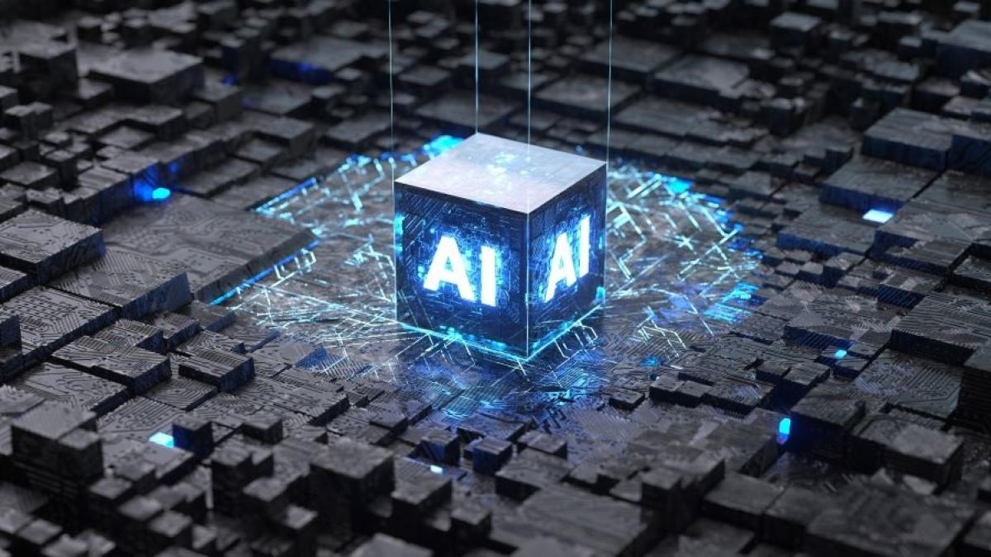
TYPES OF AI
1
Narrow AI:
Limited tasks
(e.g., Face ID)
2
General AI:
Human-like thinking
(still theoretical)
3
Super AI:
Beyond human brain (future concept)

Slide 6
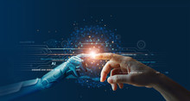
How AI Works(Simple Explanation)
1
2
3
User data, algorithms, and machine learning
Learning from patterns (e.g., YouTube suggestion)
Neural network mimic human brain processing

Slide 7

Applications of AI
Healthcare: Disease detection, robotic surgery
1
Education: Smart tutoring systems
2
Banking: Fraud detection, chat bots
3
Transport: Self-driving cars
4

Slide 8
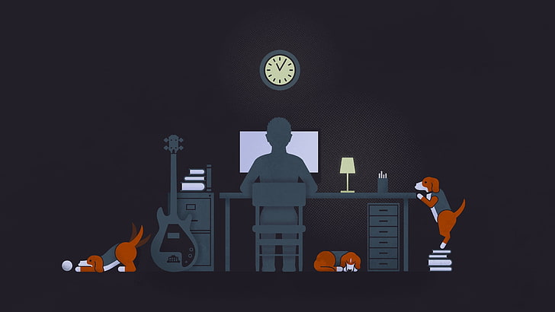
Advantages of AI
24/7 availability
Fast and accurate decisions
Reduces human error
Automates repetitive tasks

Slide 9

Challenges / Disadvantages
Job replacement and automation fear
High cost of implementation
Privacy and ethical concerns

Slide 10

The Future of AI
Emotional AI development
1
Human-AI collaboration
2
AI in space, defense, disaster prediction
3

Slide 11
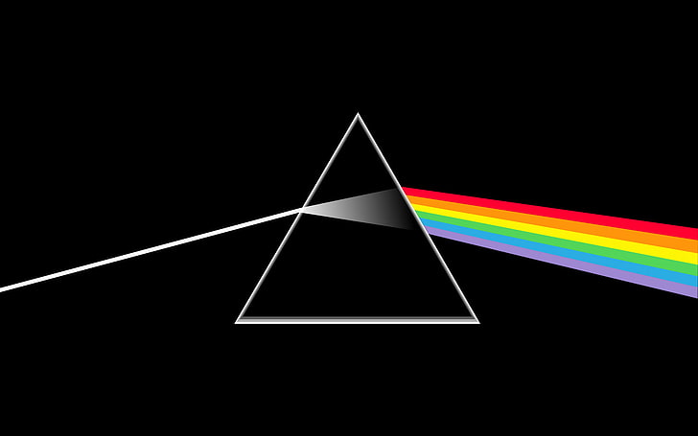
Conclusion
AI is a powerful tool – depends on how we use it
Need for ethical and responsible development

Slide 12
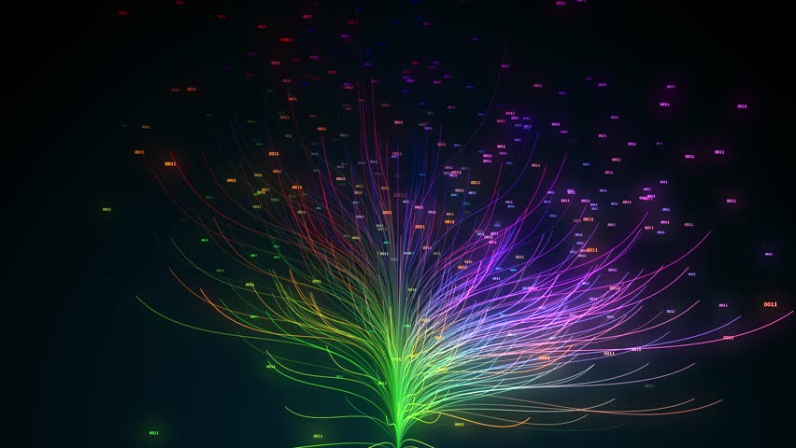
THANK YOU
Presented By: Sandeep Singh
Batch ID : 304
Date : 23/06/2025

